Slide 1

Stage 7 I Stole It From Ontario IPSC Course Designer: Marcel Englmaier
I Stole It From Ontario IPSC is a 16 round, 80 point Comstock Medium course. There are 5 USPSA targets and 6 Steel targets. The best two hits per target will score. Steel must fall to score. The start signal is audible.
The Handgun start position is standing with toes touching marks. Handgun is loaded and holstered. The PCC start position is standing with toes touching marks with PCC stock on belt, muzzle pointing downrange, and safety on.
On the audible start signal, engage all targets from within the shooting areas. PP6 activates Swinger 1

Slide 2
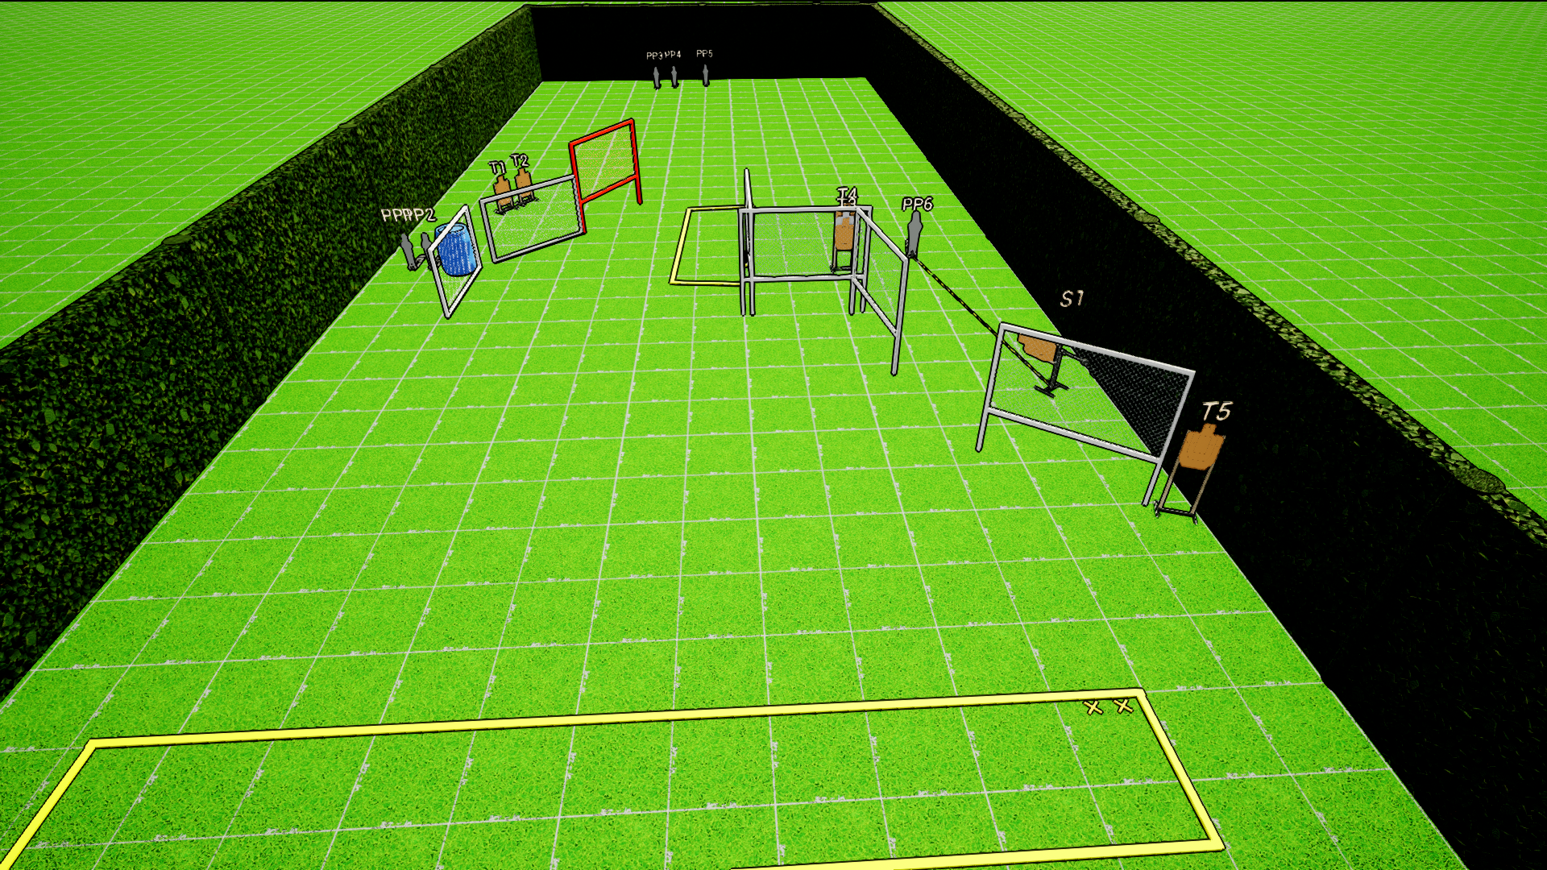
 | Stage 7 I Stole It From Ontario IPSC Course Designer: Marcel Englmaier

